Slide 1
Ch 5 Software Architecture Styles
Software System Design and Architecture
Ding Er-Yu
Software Institute, Nanjing University

Slide 2
Main Contents
An Introduction to Software Architecture Styles
Module-Level Software Architecture Styles
Process-Level Software Architecture Styles
Physical Unit-Level Software Architecture Styles
Combining Styles

Slide 3
Software Architecture Design needs Styles
D.E. Perry and A. L. Wolf
  <Foundations for the study of software architecture>, 1992
M. Shaw
  <Software Architecture: Perspectives on an Emerging Discipline >, 1996
F. Buschmann,
  <Pattern Oriented Software Architecture, vol 1~5>

Slide 4
What is a Software Architecture Style?
An architectural style defines:
  a family of systems in terms of a pattern of structural organization
  a vocabulary of components and connectors, with constraints on how they can be combined
  [Shaw & Garlan, “Software Architecture: Perspectives on an Emerging Discipline”, 1996]
An architecture style:
  Describes a class of architectures or significant architecture pieces
  Is found repeatedly in practice
  Is a coherent package of design decisions
  Has known properties that permit reuse
  [Clements, Kazman & Klein, “Evaluating Software Architecture”,2002]

Slide 5
Styles for Different-Level Components
Objects
  Design Patterns
Modules
Processes
Physical Unit

Slide 6
Main Contents
An Introduction to Software Architecture Styles
Module-Level Software Architecture Styles
Process-Level Software Architecture Styles
Physical Unit-Level Software Architecture Styles
Combining Styles

Slide 7
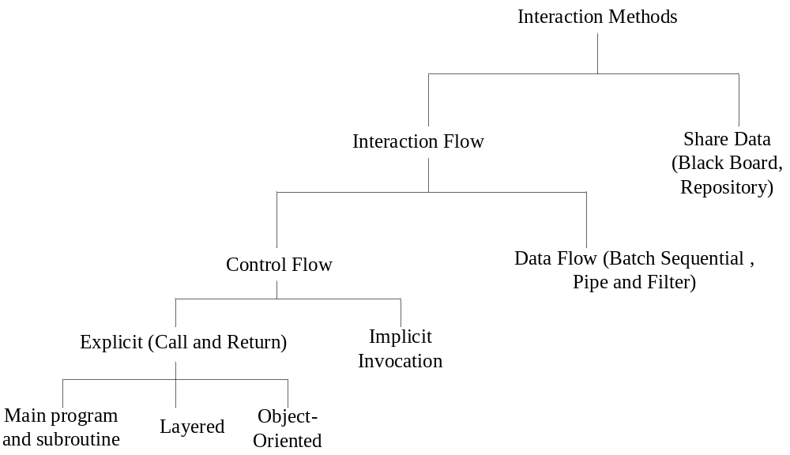
A catalog of architectural styles for modules

Slide 8
Example System: KWIC
The KWIC index system accepts:
  an ordered set of lines
  each line is an ordered set of words
  each word is an ordered set of characters
Every line is "circularly shifted" and copied by:
  repeatedly removing the first word
  appending it at the end of the line
Outputs a listing of all circular shifts of all lines in alphabetical order

Slide 9
KWIC Example
Input:
bar sock
car dog
town fog
Output:
bar sock
car dog
dog car
fog town
sock bar
town fog
Four steps:
Input
Circular shift
Alphabetize
Output
Circular shift positions: 1 5 10 14 18 23
Alphabetize:
1 10 14 23 5 18

Slide 10
Design Considerations
Changes in algorithm: line shifting can be performed …
  on each line as it is read from the input device
  on all the lines after they are read
  on demand when the alphabetization requires a new set of shifted lines
Changes in data representation: circular shifts …
  can be stored explicitly
  implicitly (as index and offsets)
Extra Features:
  Have the system eliminate circular shifts that start with certain noise words (such as "a", "an", "and", etc.).
  Make the system interactive
    allow the user to delete lines from original list and re-output alphabetized list
Performance: Both space and time
Reuse: To what extent can the components serve as reusable entities

Slide 11
Call-and-Return style
Sub-styles:
  Main-program-and-subroutine
    Decompose program hierarchically. Each component gets control from its parent.
  Object-oriented (Data Abstraction)
    Objects help achieve modifiability by encapsulating internal secrets from environment
    Access to objects is only through methods (constrained forms of procedure calls)

Slide 12
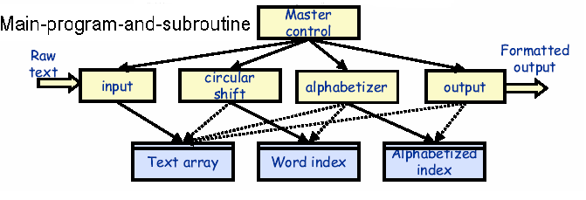
Main Program and Subroutine Architecture
Input: read lines and stores them in Text array (buffer), index records starting position of each line
Circular shift: Creates an index of starting positions for circular shifts, stores these in Word index
Alphabetizer: Takes the input from Text array and Word index, creates an index of shifts which are alphabetized

Slide 13
Design Considerations
Changes in algorithm:
  Somewhat, however explicit data structure limits possibilities
    “Show me your data structures and I’ll tell you your algorithm” – Fred Brooks
Changes in data representation:
  Not possible, because data is made available explicitly to all components.
Extra Features:
  Have the system eliminate circular shifts that start with certain noise words
    Medium, requires changes to existing component
  Make the system interactive
    Medium, requires changes to Alphabetizer
Performance:
  Space: Good, data is shared
  Time: Bad, no concurrency
Reuse: To what extent can the components serve as reusable entities
  Bad, explicit data representation dependencies

Slide 14
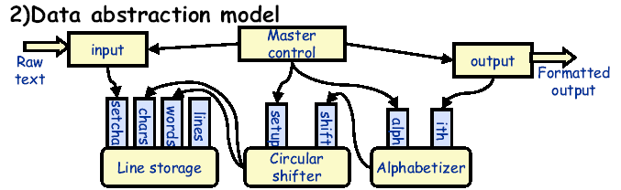
Object-Oriented Architecture
Line storage: Exports operations for getting characters in different positions
Circular shifter: function SHIFT(l,w,c) returns cth character in the wth word of the lth shift
Alphabetizer: function ITH(i) returns lines in sorted order

Slide 15
Design
Considerations
Changes in algorithm:
  Medium, data is made available through fine-grained operations, but special interface must be obeyed
Changes in data representation:
  Good, data is hidden behind interface
  Example: Line storage could keep information from disk
Extra Features:
  Have the system eliminate circular shifts that start with certain noise words
    Medium, requires changes to existing component
  Make the system interactive
    Medium, may require Alphabetizer to interact with Line storage
Performance:
  Space: Good, data can be shared through function calls
  Time: Bad, no concurrency
Reuse: To what extent can the components serve as reusable entities
  Medium, explicit interface dependencies

Slide 16
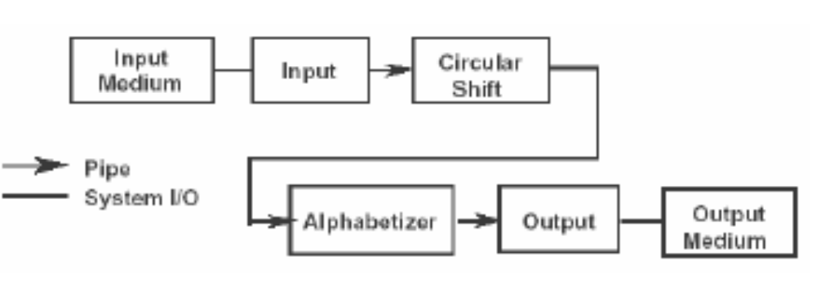
Pipe and Filter Architecture
Each filter processes the data and send to the next filter.
Each filter can run whenever it has data on which to run
Data sharing between filters is strictly limited to that transmitted on pipes

Slide 17
Design
Considerations
Changes in algorithm:
  Good, as long as it doesn’t require sharing data
  Example: Alphabetizer can use any sorting routine
Changes in data representation:
  Medium, existing pipe will be changed
Extra Features:
  Have the system eliminate circular shifts that start with certain noise words
    Good, easy to insert new component in pipeline
  Make the system interactive
    Bad, there is no stored intermediate representation
Performance:
  Space: Bad, data must be copied
  Time:
    Good, components run in parallel
    Bad, copying takes time
Reuse: To what extent can the components serve as reusable entities.
  Good, depends only on very common textual representation

Slide 18
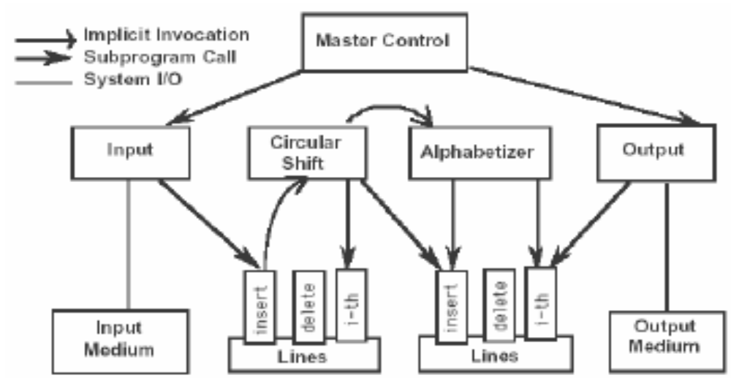
Implicit Invocation Architecture
Lines encapsulate share data, protect exposing the storage formats to the computing modules
Computations are invoked implicitly as data is modified

Slide 19
Design Considerations
Changes in algorithm:
  Good, as long as it doesn’t require sharing data
Changes in data representation:
  Medium, share data is encapsulated, but it’s still share data!
Extra Features:
  Have the system eliminate circular shifts that start with certain noise words
    Medium, requires changes to existing component
  Make the system interactive
    Medium, requires changes to existing component
Performance:
  Space: Good, data is shared
  Time:
    Good, components run in parallel
Reuse: To what extent can the components serve as reusable entities.
  Good, depends only on certain externally triggered events

Slide 20
Comparisons
 | Main-program-and-subroutine | Object-Oriented | Pipe and Filter | Implicit Invocation
Change in algorithm | Bad | Medium | Good | Good
Change in data representation | Bad | Good | Medium | Medium
Chang in functions | Medium | Medium | Good | Medium
Make system interactive | Medium | Medium | Bad | Medium
Space performance | Good | Good | Bad | Good
Time performance | Bad | Bad | Medium | Good
Reuse components | Bad | Medium | Good | Good

Slide 21
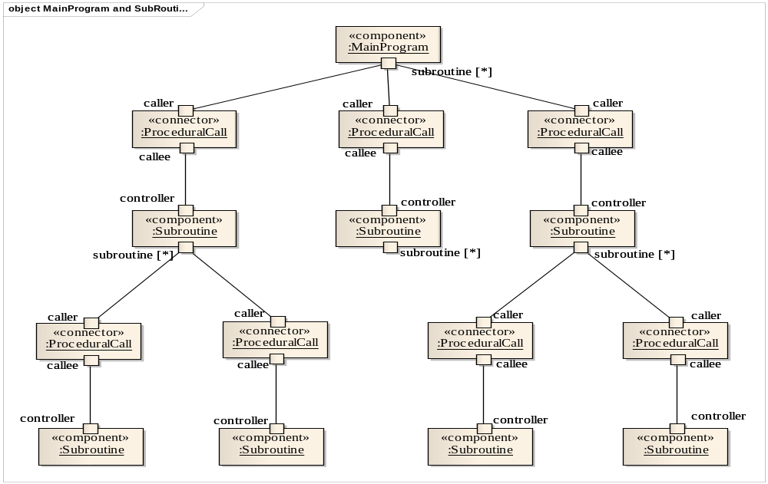
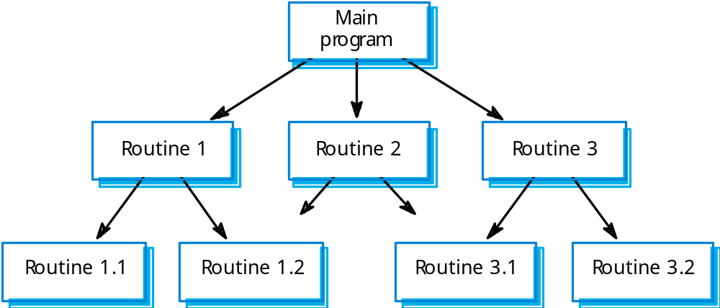
Main Program and Subroutine Style
Components: procedures , functions and module.
Connectors: calls between them.

Slide 22
Constraints
Control starts at the top of a subroutine hierarchy and moves downwards.
  Hierarchical decomposition
    Based on definition-use relationship
  Single thread of control
  Subsystem structure implicit
    Subroutines typically aggregated to modules
  Hierarchical reasoning
    Correctness of a subroutine depends on the correctness of the subroutines it calls

Slide 23
Advantages and Disadvantages
Advantages
  Clear process, easy understanding
  Strong correctness control
Disadvantages
  Difficult to change and reuse
  May be Common coupling
Applicable to
  sequential systems
  Correctness critical systems

Slide 24
Main Program and Subroutine Style
Components: package/component(UML).
Connectors: None.
Additional: Utility, tools …(replication)
逻辑设计是严格层次的
物理包不是严格层次的

Slide 25
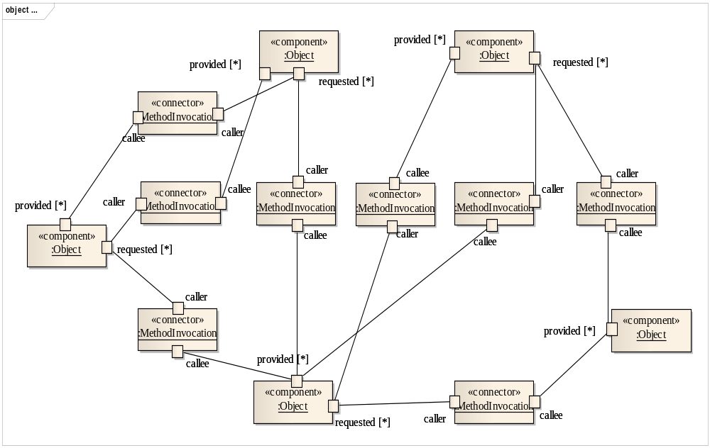
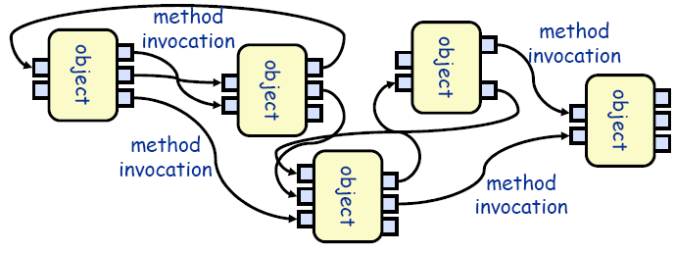
Object-Oriented Style
Components: object or module
Connectors: function or invocations (methods).

Slide 26
Constraints
The data representation is hidden from other objects.
Objects are responsible for preserving the integrity (e.g., some invariant) of the data representation.
Every objects is an autonomous agents

Slide 27
Applications of Object-Oriented Style
Suitable for applications in which a central issue is identifying and protecting related bodies of information (data).
Data representations and their associated operations are encapsulated in an abstract data type.
Examples:
  Abstract data types

Slide 28
Object-Oriented Advantages
Because an object hides its data representation from its clients, it is possible to change the implementation without affecting those clients.
  Data hiding (internal data representations are not visible to clients)
Can design systems as collections of autonomous interacting agents.
  Methods are invoked on the objects, maintaining invariants.
  Can decompose problems into sets of interacting agents

Slide 29
Object-Oriented Disadvantages
In order for one object to interact with another object (via a method invocation) the first object must know the identity of the second object.
  When the identity of an object changes it is necessary to modify all objects that invoke it.
Objects cause side effect problems:
  E.g., A and B both use object C, then B's affect on C look like unexpected side effects to A.

Slide 30
Object-Oriented Style
Components: package/component(UML).
Connectors: None / Interfaces.
Additional: Utility, tools …(replication)

Slide 31
Main Program and Subroutine VS
Object Oriented
Different in thinking way
<Structured Design Methodologies>
MPS
  (Stepwise Refinement) Functional Decomposition, && Data Flow Method
    Allocate data to functions
    Software structure is solution structure, not Problem Structure
OO
  Data-Structure Methods → Responsibility-Driven
    Allocate behavior to data (Allocate responsibility to object)
    Software (Data) structure= Problem Structure

Slide 32
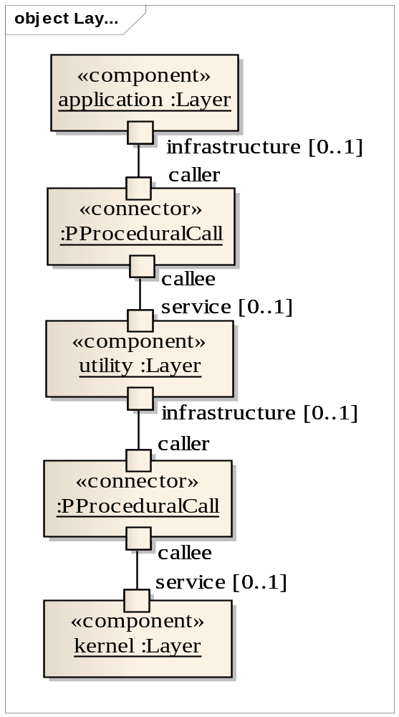
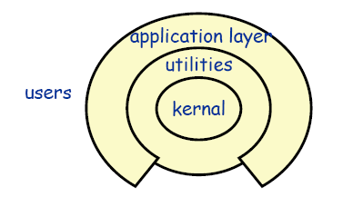
Layered Style
Components: typically collections of procedures or objects.
Connectors: typically procedure calls or methods invocations under restricted visibility.

Slide 33
Constraints
System organized hierarchically into layers, with each layer:
  Providing a service to the layer above it, and
  Acting as a client to the layer below.
  Protocol is stable and important
    Behavior (API), Data (data format, VO, POJO, etc)
Skip layers is not allowed

Slide 34
Applications of Layered Style
Suitable for applications that involve distinct classes of services that can be organized hierarchically.
  Especially when applications might be changed in some hierarchically, such as interaction, communication, hard-ware, platform, etc.
Example:
  Layered Communication Protocols:
    Each layer provides a substrate for communication at some level of abstraction.
    Lower levels define lower levels of interaction, the lowest level being hardware connections (physical layer).
  Operating Systems
    Unix

Slide 35
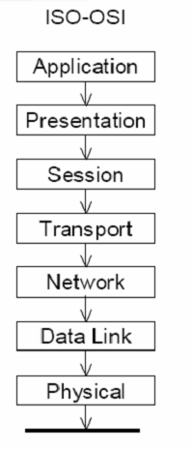
Layers in Network Protocols

Slide 36
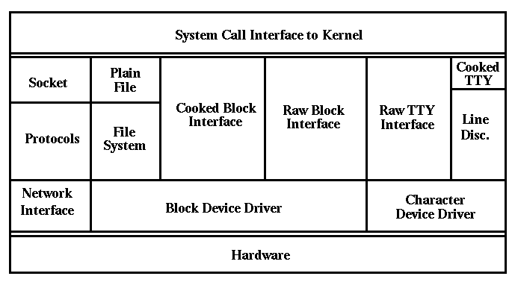
Unix Layered Architecture

Slide 37
Layered Style Advantages
Design: based on increasing levels of abstraction.
Enhancement: since changes to the function of one layer affects at most two other layers.
Reuse: since different implementations (with identical interfaces) of the same layer can be used interchangeably.

Slide 38
Layered Style Disadvantages
Not all systems are easily structured in a layered fashion.
Performance requirements may force the coupling of high-level functions to their lower-level implementations.

Slide 39
Layered Style Specializations
Often exceptions are be made to permit non-adjacent layers to communicate directly.
  This is usually done for efficiency reasons.

Slide 40
Layered Style
Components: multi package/component(UML).
Connectors: none/ Interfaces/ protocol, data.
Additional: Utility, tools …(replication)
DIP
逻辑设计是严格层次的
物理设计是非层次的

Slide 41
Main Program and Subroutine VS
Layered Style
Main Program and Subroutine
  Function Decomposition
  Y=f(x1,…xn)
  → y= f( f1(x1), fi( xi,..xj), fn(xn))
Layered
  Abstraction at different level
  Y=f(x1,…xn)
  → <x11,..x1n>=f1( x1, x2,...xn) Level n
  <x21,..x2n>=f2(x11,..x1n) Level n-1
  ...
  y=fn( xn1, xn2,...xnn) Level1

Slide 42
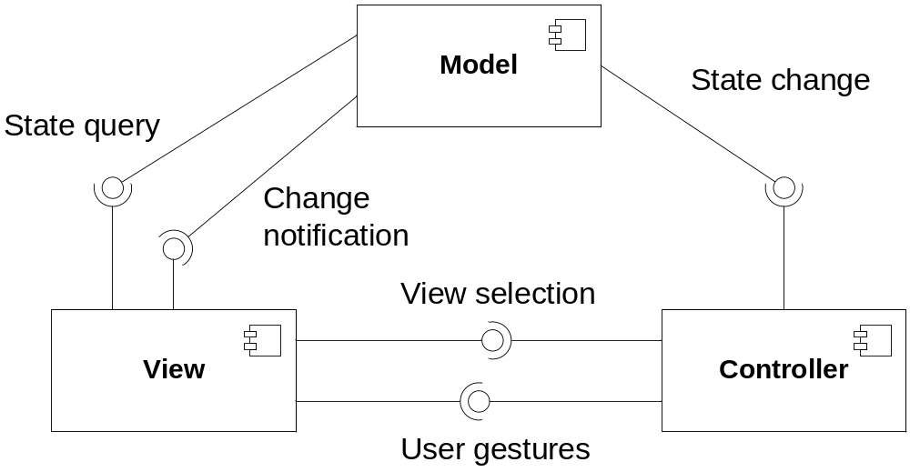
Model-View-Controller Style
The model subsystems are designed such that they do not depend on any view or controller subsystems.
Changes in their states are propagated to the view subsystems

Slide 43
Model-View-Controller Style
Components
  Model components are responsible for maintaining domain knowledge and notify view of changes
  View components are responsible for displaying information to the user and send user gestures to controller
  Controller
    Changes the state of the model
      Maps user actions to model updates
    Selects view for response
Connectors:
  Procedure calls, Messages, Events, Direct memory accesses.

Slide 44
Applications of MVC
Suitable for applications:
  Changes to user interface should be easy and possible at run-time.
  Adapting or porting the user interface should not impact the design or code in the functional part of the application.
Examples:
  Web applications

Slide 45
Model-View-Controller
Advantages:
  Allows multiple, independent views of the same model
  Views can be synchronized
  “Pluggable” views and controllers
Disadvantages:
  Increased complexity
  Inefficiency of data access in view
  Not particularly compatible with modern user interface tools.

Slide 46
Model-View-Controller Style Specializations
X
Web MVC
No Change Notification Needed!

Slide 47
Not Web Layered VS MVC
Layered
  Different abstract level
    Presentation/logic/Model is not necessary
  Protocols are stable
  Reusable, modifiability of all layers
  DIP、POJO, VO used
MVC
  Different concerns
  Models are stable
  Views and controllers modifiability
  Controller, observer, strategy used
Presentation/logic/Model Layer ≠ MVC

Slide 48
Web Layered VS MVC
Web Layered
  Different abstract level
    Presentation/logic/Model is not necessary
  Protocols are stable
  Reusable, modifiability of all layers
Web MVC
  Different concerns (technologies)
    HTML, Servlet, JavaBean
  Models are stable
  Views and controllers modifiability
Presentation/logic/Model Layer ≠ MVC

Slide 49
Implementation of styles with procedure calls
分别使用主程序-子路径、面向对象式、分层、MVC 风格实现销售功能的概要设计：
  收银员输入会员标识，系统显示会员信息
  收银员输入商品标识，系统记录商品，并显示商品信息，商品信息包括…
  系统显示已购入的商品清单，商品清单包括…
  收银员重复2-3步，直到完成所有商品的输入
  收银员结束输入，系统计算并显示总价，计算根据总额特价策略进行
  收银员请顾客支付账单
  顾客支付，收银员输入收取的现金数额
  系统给出应找的余额，收银员找零
  系统记录销售信息、商品清单、赠送清单和账单信息，并更新库存和会员信息
  系统打印收据

Slide 50
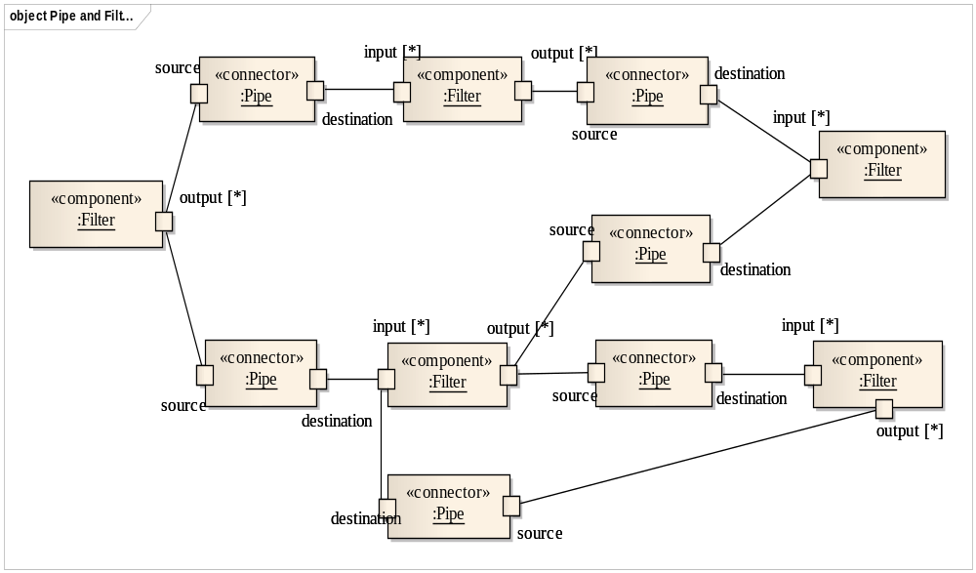
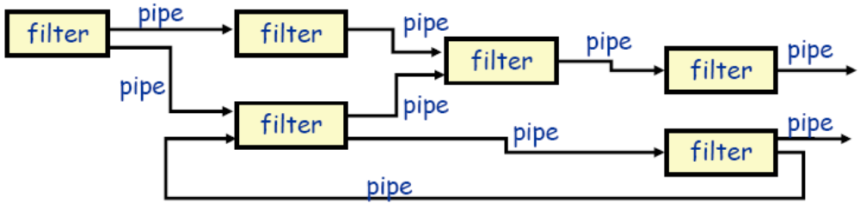
Pipe and Filter Architectural Style
Components: called filters, apply local transformations to their input streams and often do their computing incrementally so that output begins before all input is consumed.
Connectors: called pipes, serve as conduits for the streams, transmitting outputs of one filter to inputs of another.

Slide 51
Constraints
Filters do not share state with other filters.
Filters do not know the identity of their upstream or downstream filters.
The correctness of the output of a pipe and filter network should not depend on the order in which their filters perform their incremental processing.

Slide 52
Applications of Pipe and Filter
Suitable for applications that require a defined series of independent computations to be performed on ordered data.
Examples:
  Batch Sequential Programs.
  UNIX shell commands
    data. pl | grep –i fdep | grep -v FDep | less
  Compilers:
    Lexical Analysis -> parsing -> semantic analysis -> code generation
  Signal Processing

Slide 53
Pipe and Filter Advantages
Easy to understand the overall input/output behavior of a system as a simple composition of the behaviors of the individual filters.
They support reuse, since any two filters can be hooked together, provided they agree on the data that is being transmitted between them.
Systems can be easily maintained and enhanced, since new filters can be added to existing systems and old filters can be replaced by improved ones.
They permit certain kinds of specialized analysis, such as throughput and deadlock analysis.
The naturally support concurrent execution.

Slide 54
Pipe and Filter Disadvantages
Not good for handling interactive systems, because of their transformational character.
Transferring data need additional space
Excessive parsing and unparsing leads to loss of performance and increased complexity in writing the filters themselves.

Slide 55
Pipe and Filter Specializations
Pipelines
  Restricts topologies to linear sequences of filters.
Batch Sequential
  A degenerate case of a pipeline architecture where each filter processes all of its input data before producing any output.

Slide 56
Implementation of Pipe-Filter Style
Filter: package/ component（UML）
Pipe
  (1) OS Pipe
  (2) Configure, IO
    并发控制；数据资源保护
  (3) Complex Logic: Adapter, Delegator or Mediator
    With Configure and IO
Replication…
逻辑上Filter之间完全独立
物理上，并不一定独立

Slide 57
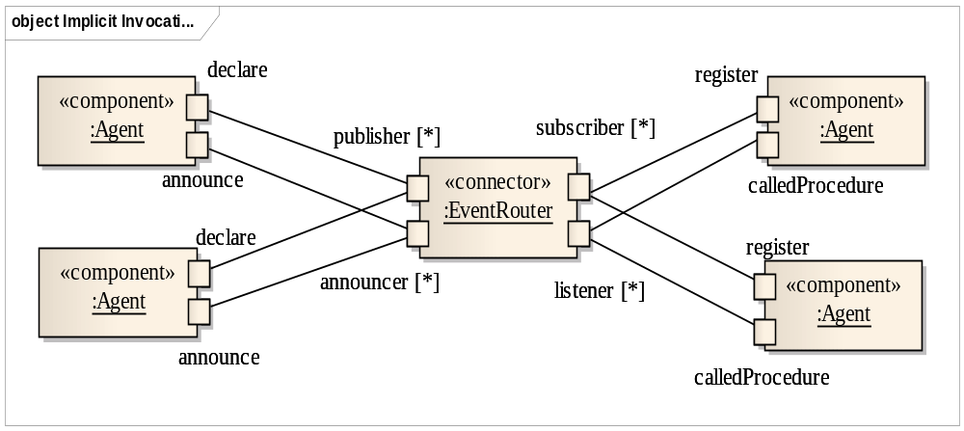
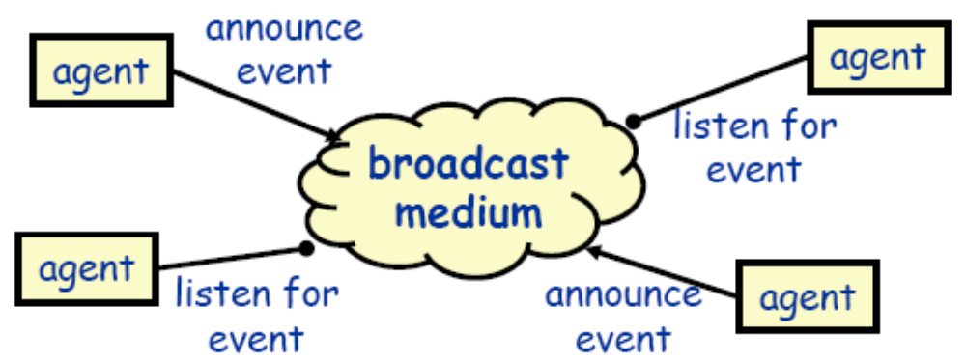
Implicit invocation (Event based ) Style
Components: agent (objects, procedures, processes)
Connectors: broadcast mediums (Events Handler)

Slide 58
Rules
Instead of invoking a procedure directly ...
  A component can announce (or broadcast) one or more events.
  Other components in the system can register an interest in an event by associating a procedure with the event.
  When an event is announced, the broadcasting system (connector) itself invokes all of the procedures that have been registered for the event.

Slide 59
Constraints
Announcers of events do not know which components will be affected by those events.
Components cannot make assumptions about the order of processing.
Components cannot make assumptions about what processing will occur as a result of their events (perhaps no component will respond).

Slide 60
Applications of Implicit Invocation
Suitable for applications that involve loosely-coupled collection of components, each of which carries out some operation and may in the process enable other operations.
Examples
  debugging systems (listen for particular breakpoints)
  database management systems (for data integrity checking)
  graphical user interfaces

Slide 61
Implicit Invocation Advantages
Provides strong support for reuse since any component can be introduced into a system simply by registering it for the events of that system.
Eases system evolution since components may be replaced by other components without affecting the interfaces of other components in the system.

Slide 62
Implicit Invocation Disadvantages
Assurance of completeness and correctness is difficult
Hard to test and diagnose
When a component announces an event:
  it has no idea what other components will respond to it,
  it cannot rely on the order in which the responses are invoked,
  it cannot know when responses are finished.

Slide 63
Implementation of Implicit Invocation Style
Agent: Package / component(UML)
Event broadcaster
  A manager
    Dictionary Management
    “Call Back”
    register; unregister; announce; notify
  Event (exception) Tree
  Event (exception) Package
Replication…
逻辑上Agent之间完全独立, 物理上不一定

Slide 64
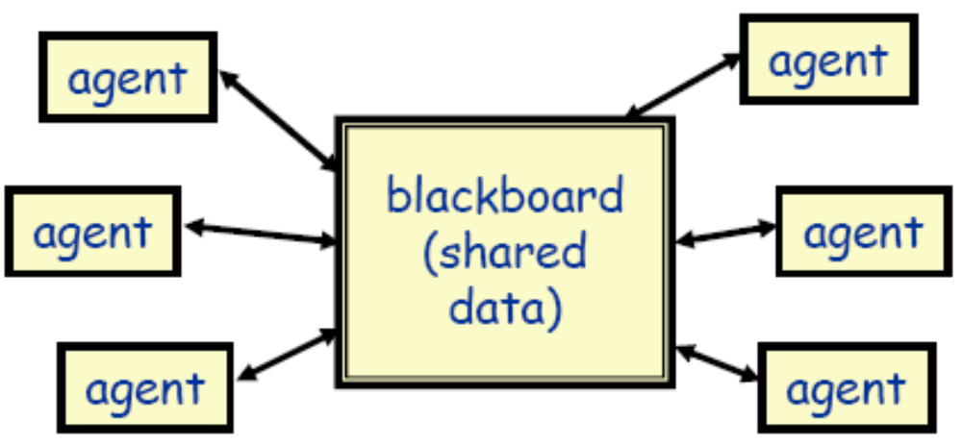
Repository (Blackboard) Style
Components:
  A central data structure representing the correct state of the system.
  A collection of independent components that operate on the central data structure.
Connectors:
  Typically procedure calls or direct memory accesses.

Slide 65
Constraints
All agents are “independent” to each other
Each agent is dependent to shared data
Agents check data states and react
  Push VS Pull

Slide 66
Repository vs. Blackboard
Repository uses “pull” model
  Components write data in the repository
  Components read data from the repository
  Example: Web log
  Easy to implement
  Clients become complex and must poll for data
Blackboard uses “push” model
  Components register data subscription
  Components are notified when data is available
  Example: Chat room
  Client programming is simplified
  Requires complex infrastructure

Slide 67
Applications of Repository Style
Suitable for applications in which the central issue is establishing, augmenting, and maintaining a complex central body of information.
  Typically the information must be manipulated in a variety of ways. Often long-term persistence is required.
Examples:
  databases
  blackboard expert systems
  programming environments

Slide 68
Repository Style Advantages
Efficient way to store large amounts of data.
Sharing model is published as the repository schema (good for space performance).
Reduce the need to duplicate complex data (good for time performance)
Centralized management :
  Backup (increase fault-tolerance )
  Security (increase security)
  concurrency control (good for time performance)

Slide 69
Repository Style Disadvantages
Must agree on a data model a priori.
Blackboard becomes a bottleneck
Data evolution is expensive.

Slide 70
Implementation of Repository/Black-Board Style
Simple Repository
  DB Service
Complex Repository
  Complex share-data logic
    Concurrent control
Black-Board Style
  Repository with Monitor
    Dictionary control (data condition): (un)register
    Data access control

Slide 71
Implicit invocation Style VS
Black-Board Style
Event Router : connector
BlackBoard (ShareData): Component

Slide 72
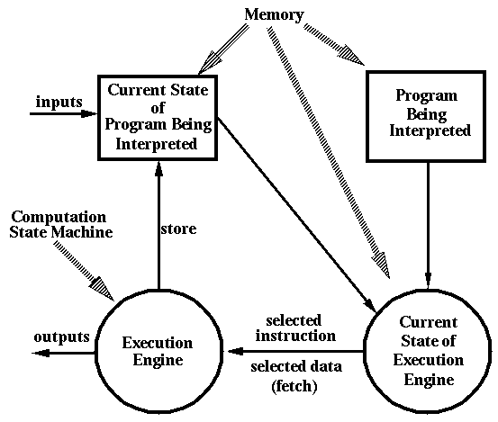
Interpreter Style (extended style)

Slide 73
Interpreter Style (Cont’d)
Components: include one state machine for the execution engine and three memories:
  current state of the execution engine
  program being interpreted
  current state of the program being interpreted
Connectors:
  procedure calls
  direct memory accesses.

Slide 74
Interpreter Style
Suitable for applications in which the most appropriate language or machine for executing the solution is not directly available.

Slide 75
Interpreter Style Examples
Programming Language Compilers:
  Java
  Smalltalk
Rule Based Systems:
  Prolog
  Coral
Scripting Languages:
  Awk
  Perl

Slide 76
Interpreter Style Advantages
Simulation of non-implemented hardware.
Facilitates portability of application or languages across a variety of platforms.

Slide 77
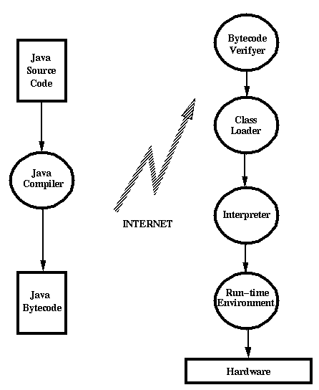
Java Architecture

Slide 78
Interpreter Style Disadvantages
Extra level of indirection slows down execution.
Java has an option to compile code.
  JIT (Just In Time) compiler.

Slide 79
Implementation of styles
分别使用Pipe-Filter, Implicit Invocation, Black-Board 实现KWIC系统

Slide 80
Another Example: Mobile Robotics
The system controls a manned or partially manned vehicle
  Car, submarine, …
Build software to control the robot
  External sensors and actuators
  Real-time
Input provided by sensors
Control the motion
Plan the future path

Slide 81
Another Example: Mobile Robotics
Design considerations
  Req 1: deliberative and reactive behavior
    Coordinate robot actions with environment reactions
  Req 2: uncertainty
    The robot need to act based on incomplete and unreal information
  Req 3: account for dangers
    Fault tolerance, safety, performance
  Req 4: flexibility
    Application development requires experimentation and reconfiguration

Slide 82
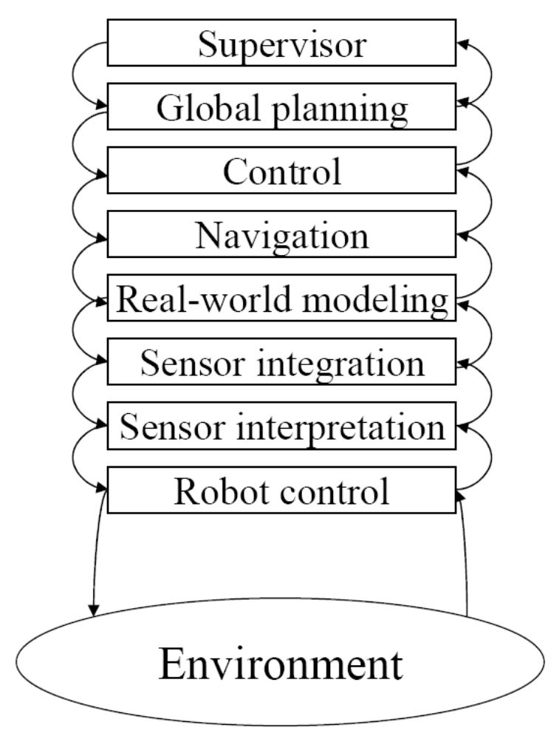
Layered Architecture
Eight (8) levels:
  Level 8: user interface and supervisory functions
  Levels 6&7: scheduling and planning of robot actions
  Level 5: navigation
  Level 4: robot’s model of the world
  Levels 2&3: input from the environment
    Sensor interpretation and integration
  Level 1: Robot control (motors, joints, …)

Slide 83
Layered Architecture
Req 1: deliberative and reactive behavior
  + More components to delegate tasks
  + indicates concerns that must be addressed
  + defines abstraction levels to guide the design
  - does not fit the actual data and control-flow patterns
    Data requiring fast reaction may have to be sent directly from the sensors to the problem-handling agent at level 7
    and the corresponding commands may have to skip levels to reach the motors in time.
  - does not separate the data hierarchy from the control hierarchy
    raw sensor input - level 1, interpreted and integrated results - 2 and 3, world model – 4
    motor control - level 1, navigation - 5, scheduling - 6, planning - 7, user-level control - 8

Slide 84
Layered Architecture
Req 2: uncertainty
  + Abstraction layers addresses the need for managing uncertainty
    what is uncertain at a lowest level may become clear in the higher layers (e.g: the context embodied in the world model can provide the clues to disambiguate conflicting sensor data)
  - There is no clear mechanism to do that
Req 4: flexibility
  - complex relationships between layers can become difficult to manage and interlayer dependencies an obstacle

Slide 85
Layered Architecture
Req3: account for danger
  + Fault tolerance and passive safety (when you strive not to do something) served by the abstraction mechanism.
    Data and commands are analyzed from different perspectives.
    Possible to incorporate many checks and balances.
  - Performance and active safety (when you have to do something rather than avoid doing something) may require communication pattern be short-circuited.

Slide 86
Layered Architecture
Summary:
  Abstraction levels defined by the layered architecture
    provide a framework for organizing components
    framework succeeds because it is precise about the roles of the different layers
  Major drawbacks
    model breaks down when taken to the greater level of detail demanded by an actual implementation.
    Communication patterns in a robot not likely to follow the orderly scheme implied by the architecture.

Slide 87
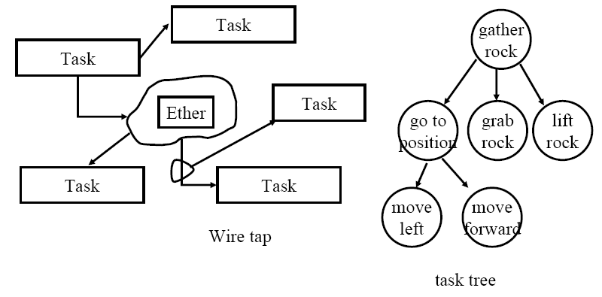
Implicit Invocation Architecture
Based on hierarchies of tasks (task trees).
  May be dynamically reconfigured (changing robot state and environmental conditions).
Uses implicit invocation to coordinate interactions between tasks.
  Tasks communicate by multicasting messages via a message server, which redirects those messages to tasks that are registered to handle them

Slide 88
Implicit Invocation Architecture
Exceptions: Certain conditions cause the execution of an associated exception handler
  Exception override currently executing task in the subtree that cause the exception.
  Exception quickly change the processing mode of the robot.
Wiretapping: Message can be intercepted by tasks superimposed on an existing task tree.
  For instance can be used by a safety-check component to validate outgoing motion commands.
Monitors: Read information and execute some action if the data fulfills a certain criterion
  Example battery check.
  Offers a convenient way of dealing with fault-tolerance issues by setting aside agents to supervise the system.

Slide 89
Implicit Invocation Architecture
Req 1: deliberative and reactive behavior
  + Separation of action and reaction via the task trees, exceptions, wiretapping, monitor
  + concurrency explicit: multiple actions can proceed simultaneously and independently
Req 2: uncertainty
  - uncertainty treatment is less clear
  + Maybe via task trees and exceptions

Slide 90
Implicit Invocation Architecture
Req 3: account for danger
  + Exception, wiretapping, and monitoring features take into account the needs for performance, safety, and fault tolerance
  + With Multiple handles for same signal concurrently, fault tolerance (redundancy), performance (concurrency), and safety also benefit.
Req 4: flexibility
  + implicit invocation allows incremental development and replacement of components

Slide 91
Implicit Invocation Architecture
Summary:
  Comprehensive set of features for coordinating the tasks of a robot while respecting the requirements for quality and ease of development.
  The richness of the scheme makes it most appropriate for more complex robot projects.

Slide 92
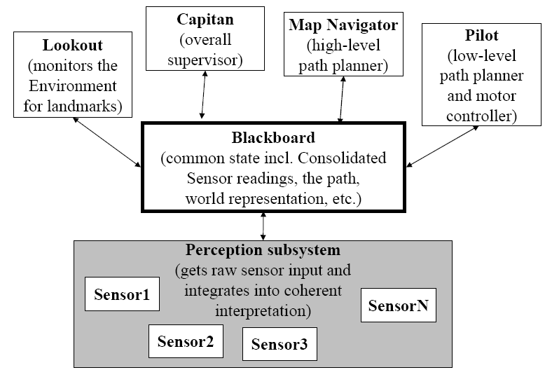
Black-Board Architecture

Slide 93
Black-Board Architecture
Req 1: deliberative and reactive behavior
  +Communication via the shared repository can be heavy.
    Control flow has to be coerced to fit the database mechanism
Req 2: uncertainty
  +Blackboard is the means for resolving conflicts or uncertainties in the robot's world view
Req 3: account for danger
  + Exception mechanism, wiretapping, and monitoring can be implemented by defining separate modules that watch the database for the signs of unexpected occurrences or the beginnings of troublesome situations.
Req 4: flexibility
  + Supports concurrency and decouples senders from receivers, Facilitates maintenance

Slide 94
Black-Board Architecture
Summary: Blackboard architecture
  is capable of modeling the cooperation of tasks, both for coordination and resolving uncertainty in a flexible manner, thanks to an implicit invocation mechanism based on the contents of the database.

Slide 95
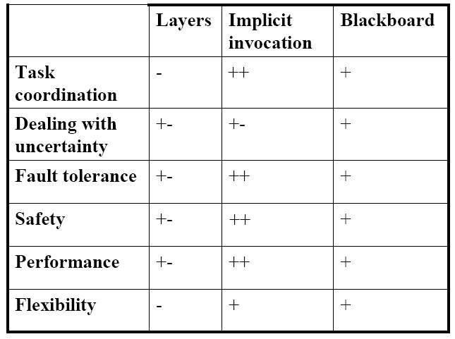
Comparison

Slide 96
Main Contents
An Introduction to Software Architecture Styles
Module-Level Software Architecture Styles
Process-Level Software Architecture Styles
Physical Unit-Level Software Architecture Styles
Combining Styles

Slide 97
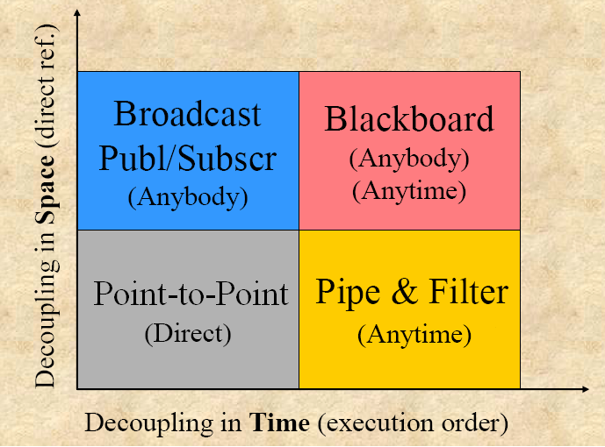
A catalog of architectural styles for processes

Slide 98
Point-to-Point Architecture Style
Socket Connection: synchronous
Remote procedure calls: synchronous
  RMI/DPRC(COM+,.Net)
Asynchronous Messaging in Distributed Systems
  Loosely coupled architectures
  Components come and go as they please

Slide 99
Point-to-Point Architecture Style Implementation
Connector
  Network Service
  Broker (remote proxy)

Slide 100
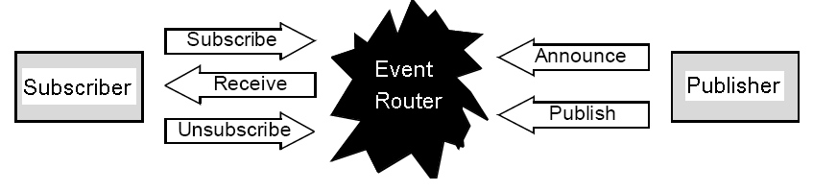
Publish-Subscribe Architecture Style
Multiple applications need to receive the same message (broadcast)
Publishers and Subscriber and loosely coupled
Delivery is based on event subscriptions
Event topics (types) organized hierarchically
Components:
  Publisher/Subscriber
Connector:
  Event Router

Slide 101
Main Contents
An Introduction to Software Architecture Styles
Module-Level Software Architecture Styles
Process-Level Software Architecture Styles
Physical Unit-Level Software Architecture Styles
Combining Styles

Slide 102
A catalog of architectural styles for physical unit
Client-Server
Three-Tier (N-Tier)
Peer-to-Peer
Distributed System
  Distributed Objects (middleware)
  Distributed Resources (http)
  Distributed Services (web service)

Slide 103
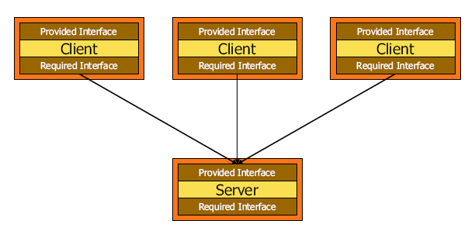
Client-Server Architecture Style
Instance of a more general style
  Distributed systems
Components are clients and servers do not know number or identities of clients
Clients know server’s identity
Connectors are RPC-based interaction protocols
A number of different flavors of client-server
Example: File server, web server, ftp server, e-mail server

Slide 104
Client-Server Architecture Style
Implementation
Connector Rules:
  Server initialization
  Client start ( configuration Ref of Server)
  Server response
Connector Implementation
  Link (Stated)
  Message (Stateless)

Slide 105
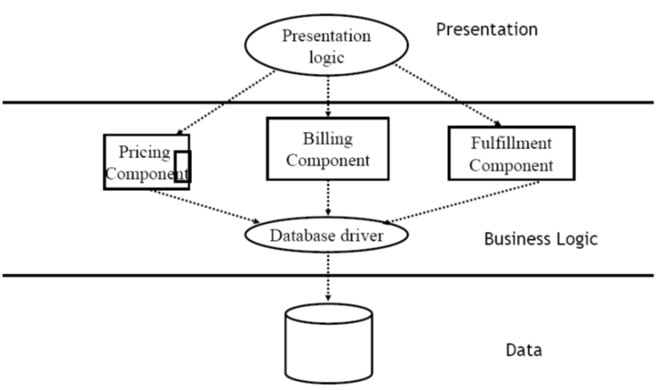

Three-Tier Style

Slide 106
Three-Tier Architecture Style
Three subsystem layers:
  interface layer (or front end) : subsystems that communicate with the user
    contain interfaces, web pages, forms, etc.
  application logic layer : contains the processing units
  storage layer ( or back end): deals with storage query and retrieval of persistent data
Like the client/server models with another layer added in between
Provides separation of user interface and application logic.

Slide 107
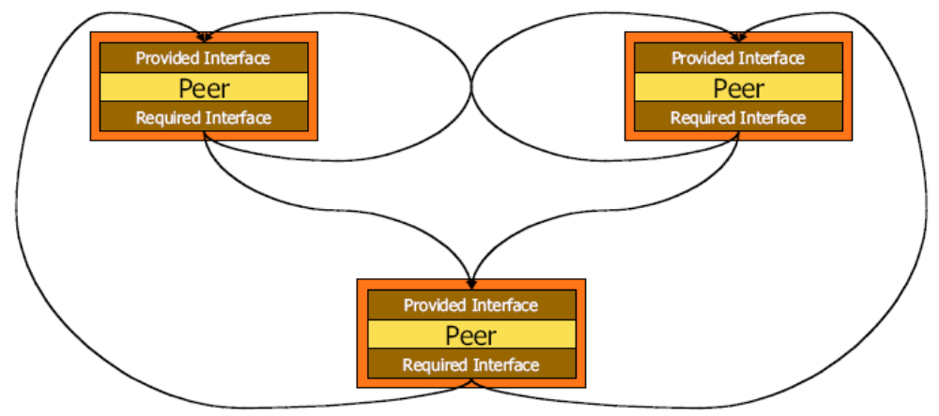
Peer to Peer Architecture Style
Components
  Autonomous
  Act as both clients and servers
Connectors
  Asynchronous and synchronous message passing ("remote procedure calls")
  No shared memory (except as an optimization when the configuration allows)
Topology
  Interaction topologies can vary arbitrarily and dynamically

Slide 108
Peer to Peer Architecture Style
A generalization of the client/server architecture where:
  each subsystem can act as both a client and a server
    i.e. both subsystems can request and provide services.
Generally it is more difficult to implement peer-to-peer systems than client/server systems
  control flow becomes more complicated
  each subsystem has its own control flow which must be synchronized when requests are made of the other subsystem.
Examples: eMule, eDonkey, Gnutella, Freenet, On Share, etc. are examples of a P2P systems
  a central server is used only to connect two client machines for the purposes of file sharing.
  the two client machines then communicated as peer-to-peer.

Slide 109
Peer to Peer Architecture Style Implementation
Connector Rules:
  Server initialization ?
  Client start ( configuration Ref of Server ?)
  Server response
Connector Implementation
  Link (Stated)
  Message (Stateless)
Connector
  Link (Stated)/ Message (Stateless)
  Configuration ref of Server Manager
Server (Ref) Manager
  Initialization and exit (Ping/Echo)
  Distributed Ref (HeartBeat)

Slide 110
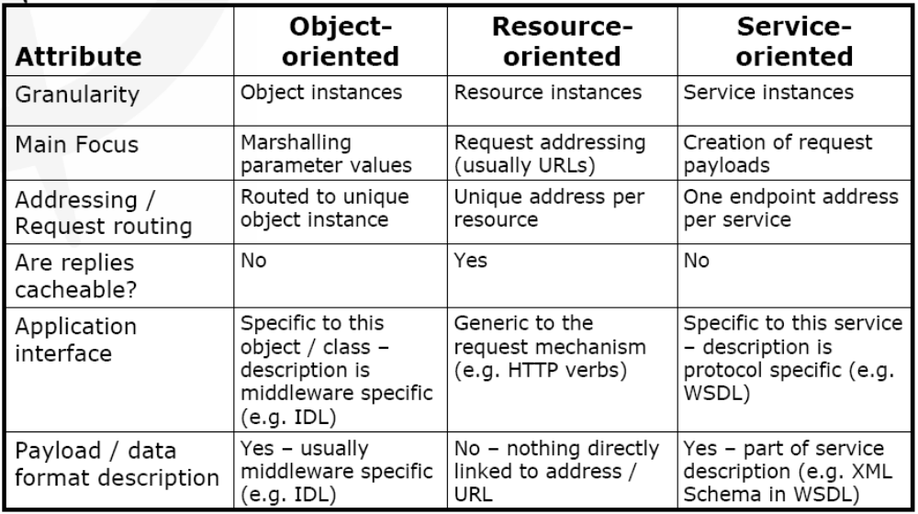
Distributed Architecture Styles

Slide 111
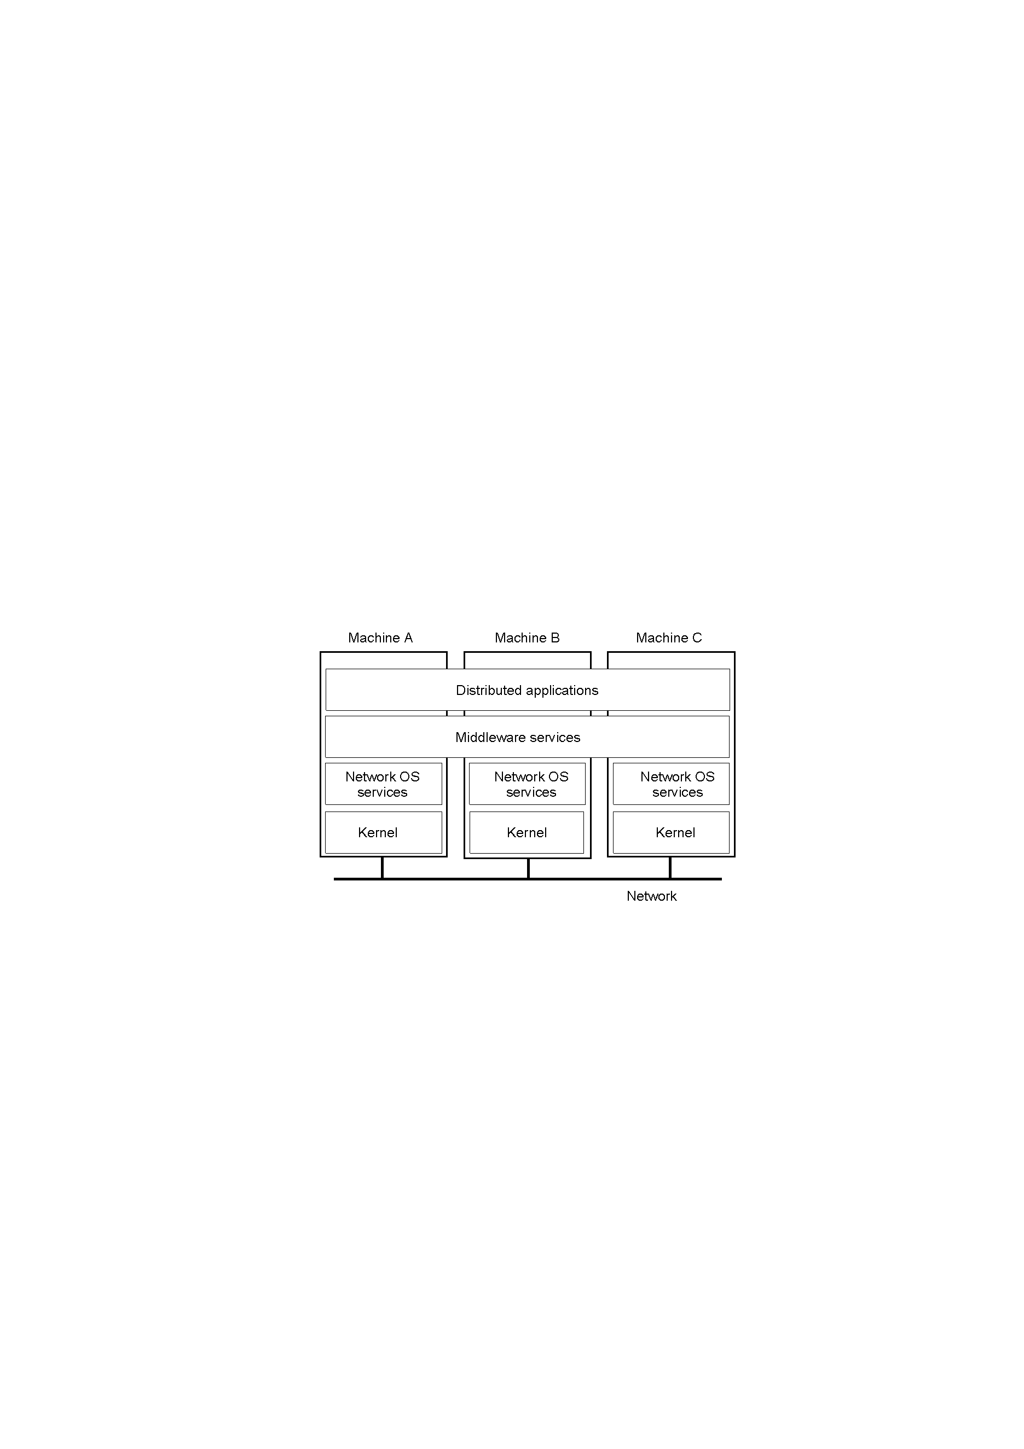
Middleware-Oriented Distributed System Architecture Style
Implementation
:Middleware Platform

Slide 112
Main Contents
An Introduction to Software Architecture Styles
Module-Level Software Architecture Styles
Process-Level Software Architecture Styles
Physical Unit-Level Software Architecture Styles
Combining Styles

Slide 113
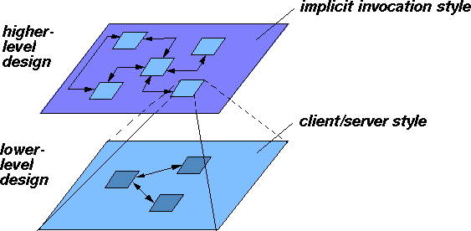
Combining Styles
Systems are not usually developed according to a single,
consistent idiom. Variations may occur at different levels
of refinement/abstraction.

Slide 114
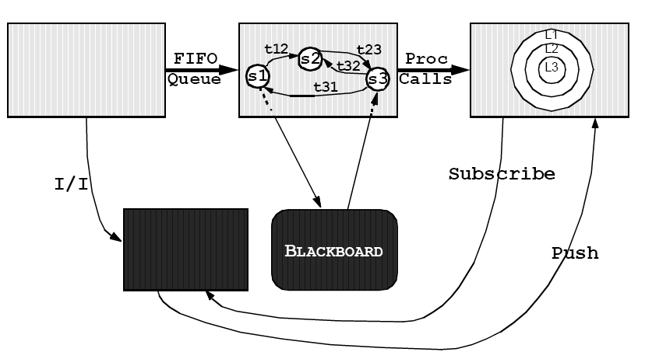
An Example of Combining Styles

Slide 115
Conclusions

Slide 116
Conclusions

Slide 117
Conclusions
Client-Server
Three-Tier (N-Tier)
Peer-to-Peer
Distributed System

